Slide 1
Multi-Label Classification & SSD Object Detection

Slide 2
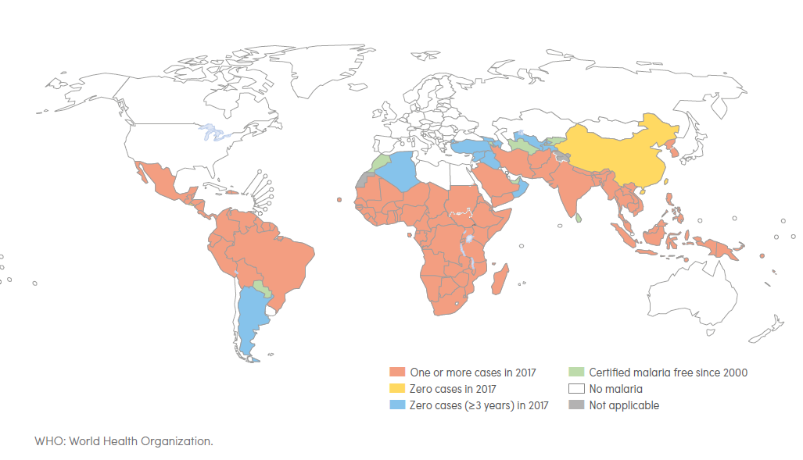
Malaria Trends & Countries
Current gold standard for detecting malaria cells is manually by trained microscopists
Manual screening performance decreases at large scales in resource strained countries
Machine-learning can help large-scale screening without compromising accuracy
Convolutional Neural Nets (CNN) most popular choice
Source: Figure generated using WHO Malaria Report 2018 Table 6.1 pg. 37
Source: WHO Malaria Report 2018 pg. 2

Slide 3
Goals & Strategies
Goal: Identify the types of malaria-infected cells that exist in an image and red blood cells and leukocytes
Strategies:
(Classification Only) Feed each image through a CNN and let it identify the type of infected cell(s) the image contains without finding its location in the image, i.e. no bounding boxes.
(Object Detection Problem) Feed each image through a CNN and let it identify the type of infected cell(s) the image contains and find it’s location, i.e. find bounding boxes

Slide 4
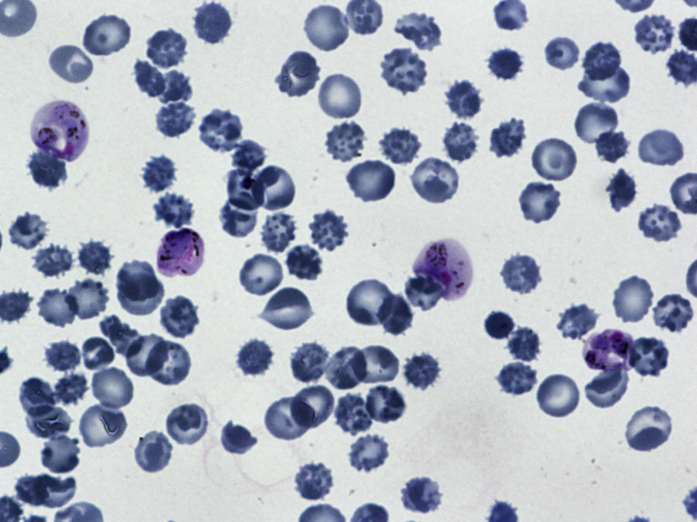
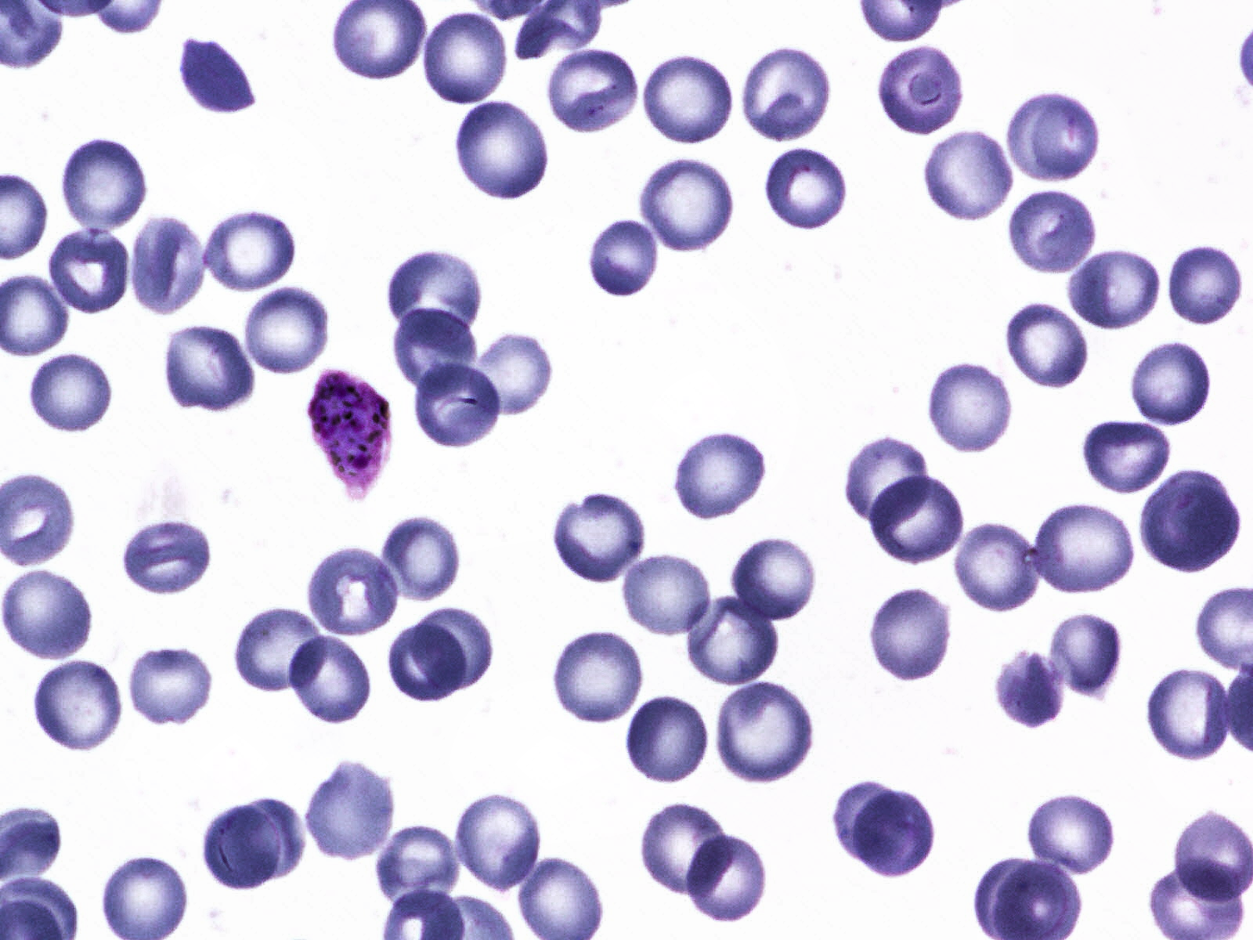
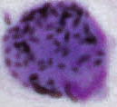
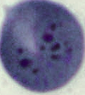
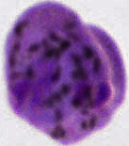
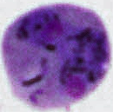
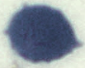
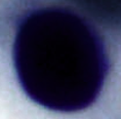
Sample Images from Dataset
Infected Cells
Uninfected Cells
Gametocyte
Ring
Schizont
Trophozoite
Red-blood cell (RBC)
White blood cell (Leukocyte)

Slide 5
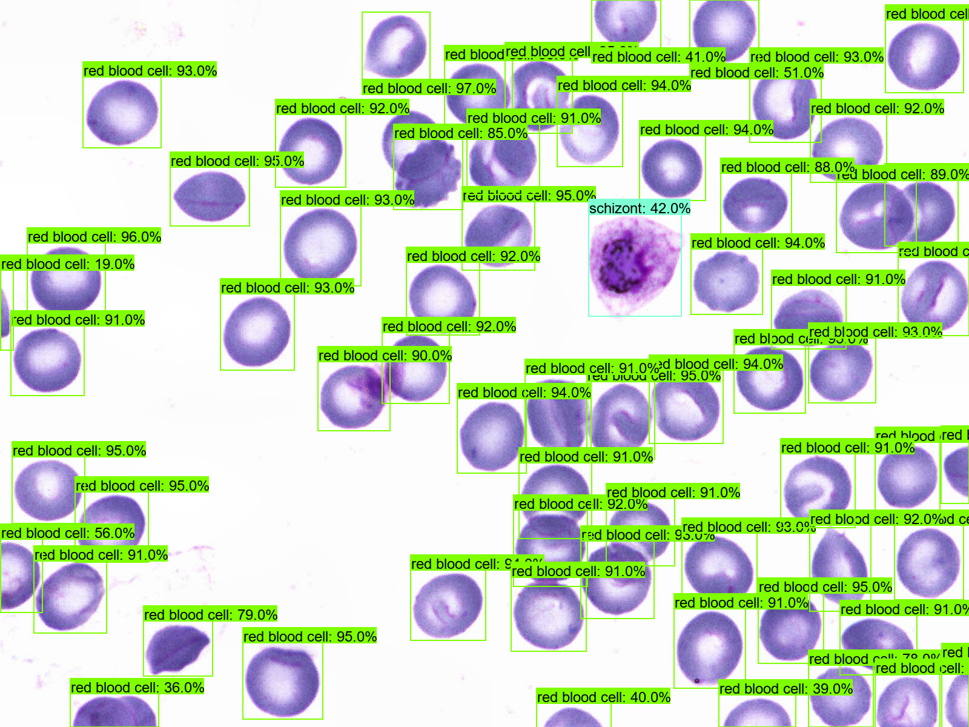
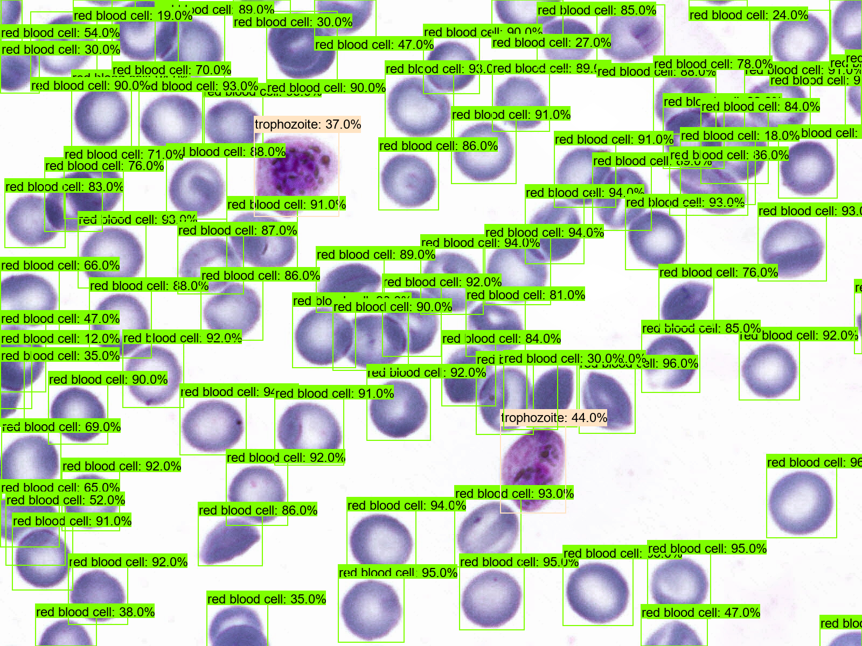
Sample Results of Object Detection Strategy
Cell types & amount of images that contain each in test set (390 images):
Red blood cell: 390, Leukocyte: 33, Schizont: 49, Gametocyte: 45, Ring: 78, Trophozoite: 193
Cell type & counts across all test images:
Red blood cell: 25616, Leukocyte: 37, Schizont: 55, Gametocyte: 48, Ring: 116, Trophozoite: 491

Slide 6
Results of Classification Strategy
Results of multi-label image classification without bounding boxes with different Feature Extractors
Each Feature Extractor trained for 50 epochs
Feature Extractor | Overall Accuracy (%) | Overall Precision (%) | Overall Recall (%) | Overall F-score (%)
ResNet50V2 | 87.4 | 94.3 | 66.6 | 78.1
InceptionV3 | 87.1 | 90.1 | 69.2 | 78.3
Xception | 87.8 | 94.7 | 67.5 | 78.8
Feature Extractor | Class Accuracy (%) | Class Precision (%) | Class Recall (%) | Class F-score (%)
ResNet50V2 | 100,91.5,87.4,88.5,80,76.9 | 100,NaN,NaN,NaN,NaN,80.8 | 100,0,0,0,0,69.9 | 100,NaN,NaN,NaN,NaN,75
InceptionV3 | 100,89.7,87.9,88.5,81.3,74.9 | 100,37,56.2,NaN,55.8,86.8 | 100,30.3,18.4,0,30.8,58 | 100,33.3,27.7,NaN,39.7,69.5
Xception | 100, 91.5,87.4,88.5,79.7,79.5 | 100,NaN,NaN,NaN,45.5,85.1 | 100,0,0,0,6.4,71 | 100,NaN,NaN,NaN,11.2,77.4
Order of results: [Red blood cell, Leukocyte, Schizont:, Gametocyte, Ring, Trophozoite]

Slide 7
Results of multi-label image classification with bounding boxes with different Feature Extractors
All models trained for 12000-25000 steps with TensorFlow 2 (TF2) Object Detection API
Feature Extractor | mAP (IoU=0.5) (%) | AR@100 (%) | AR@10 (%) | AR@1 (%)
SSD ResNet50 V1 FPN 640x640 (RetinaNet50) | 64.1 | 74.2 | 63 | 41.2
EfficientDet D2 768x768 | 34.7 | 51.9 | 41.4 | 25.9
SSD MobileNet V1 FPN 640x640 | 66.3 | 72.8 | 61.7 | 41.1
[COCO 2017 Metrics]
Feature Extractor | Overall Accuracy (%) | Overall Precision (%) | Overall Recall (%) | Overall F-score (%)
SSD RetinaNet50 640x640 | 91.98 | 69.67 | 70.64 | 70.15
EfficientDet D2 768x768 | 88.3 | NaN | 37.49 | Nan
SSD MobileNet V1 FPN 640x640 | 91.3 | 67 | 68.4 | 67.7
Feature Extractor | Class Accuracy (%) | Class Precision (%) | Class Recall (%) | Class F-score (%)
SSD RetinaNet50 640x640 | 100,96.5,89.4,87,91.1,87.9 | 100,73.7,51.6,37.7,78.7,76.4 | 100,84.8,32.7,57.8,61.5,87 | 100,78.9,40,45.6,69.1,81.4
EfficientDet D2 768x768 | 100,92.2,87.5,87.3,82.6,80 | 100,NaN,34.6,25.9,17.9,63.8 | 100,0,18.4,15.6,17.9,73.1 | 100,NaN,24,19.4,24.8,68.1
SSD MobileNet V1 FPN 640x640 | 100,96.8,90.3,89.4,86.8,84.7 | 100,72.1,56.8,45.5,50,67.7 | 100,93.9,42.9,33.3,54.5,90.2 | 100,81.6,48.8,38.5,54.5,77.3
Order of results: [Red blood cell, Leukocyte, Schizont:, Gametocyte, Ring, Trophozoite] using task-specific custom metrics

Slide 8
Conclusions
Best strategy: Object Detection (OD)
Higher overall accuracy compared to classification (91.98 vs 87.8)
F-score is lower for OD but this is because there are few samples of infected cell types for training. This will improve with more samples
Classification models didn’t successfully detect certain types of infected cells (ex. gametocyte). This could be an issue with images that contain that cell type
OD models successfully detected all cell types and F-scores will improve with more samples

